Slide 1
My Solo Project
Sehher Tariq
Notes:
http://34.89.69.35/

Slide 2
Objectives
Create an application of our choice
Create, Read, Update and Delete (CRUD) functionality
Utilise technologies that we have learned

Slide 3
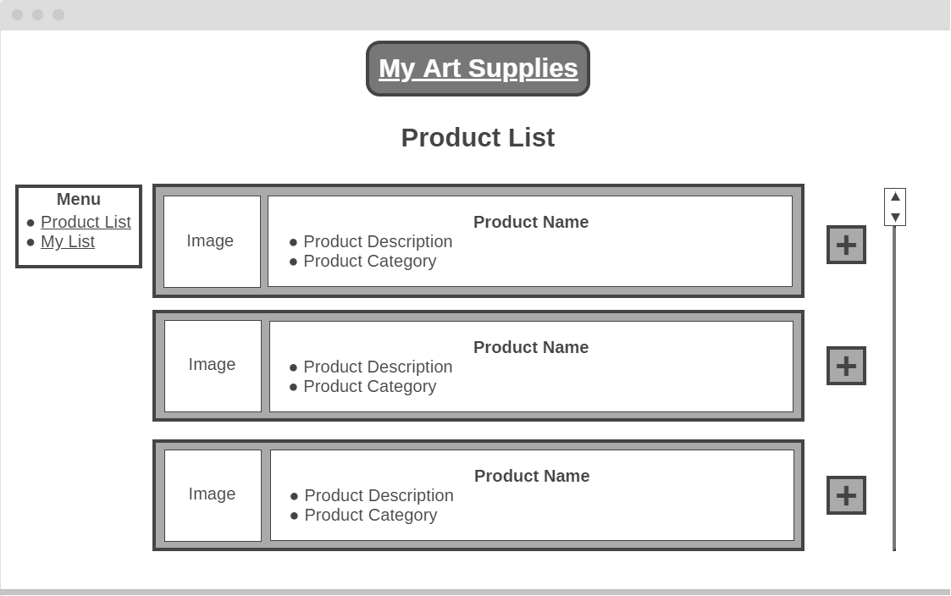
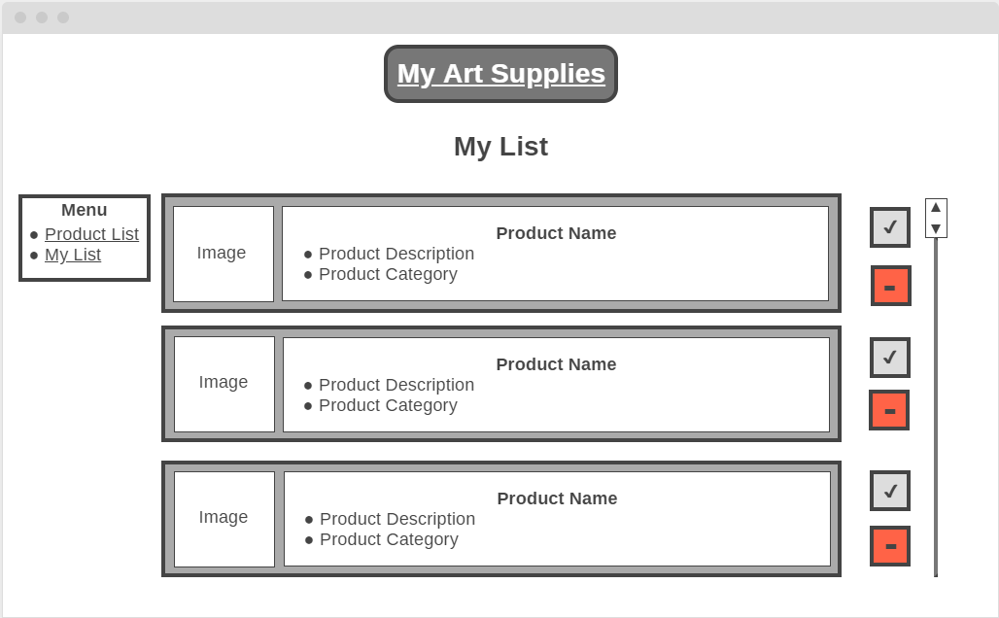
What Was My Idea?
An application for tracking art supplies
My ideal solution:
One list of general art supplies which can be added to
A second list which contains products added from product list which is for a specific project

Slide 4
User Stories
As a user, I want to create a list of art supplies that I want to get for my project, so that I can keep track of what to buy.
As a user, I want to separate my supplies into categories, so that I can separate out my list.
As a user, I want to create new entries for products, so that I can add new types of art supplies.
As a user, I want to update product entries, so that I can edit entries that have been entered incorrectly.

Slide 5
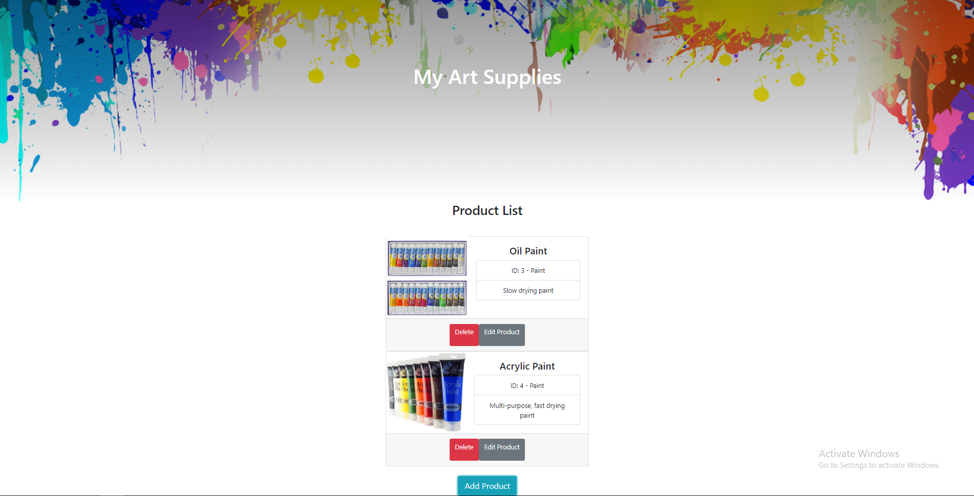
What My Application Looks Like

Slide 6
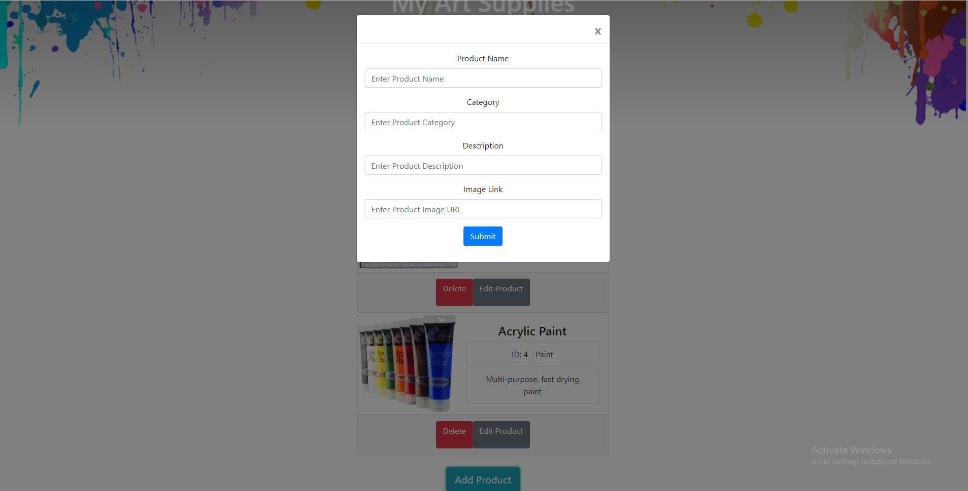
Create
Notes:
http://www.signifysigns.co.uk/wp-content/uploads/2015/11/black-canvas.jpg

Slide 7
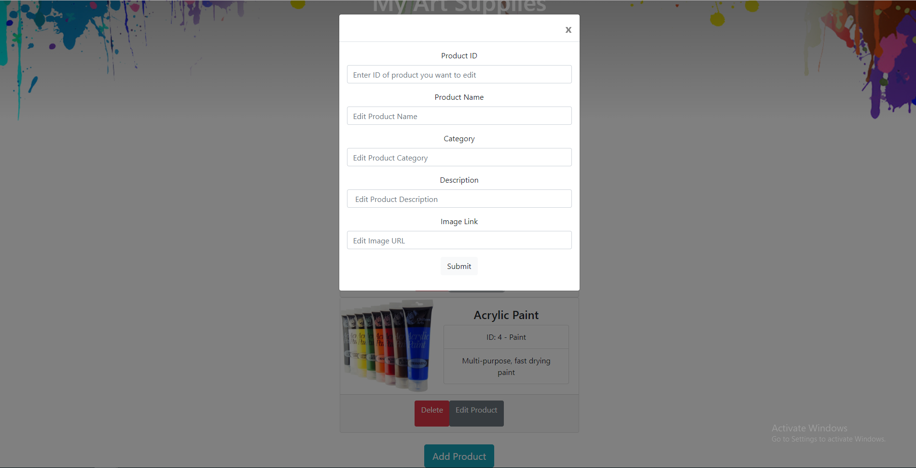
Update

Slide 8
API Structures
Products
Service
Products Controller
Products Model
Long id
String name
String category
String description
String imageUrl
listAllProducts
addProduct
getProduct
updateProduct
deleteProduct
listAllProducts
addProduct
getProduct
updateProduct
deleteProduct
Product Repository

Slide 9











Tools Used
Version Control - GitHub
IDE and language – IntelliJ with Java
Database – H2
Front End – HTML, CSS, JavaScript
Continuous Integration – Jenkins, Google Cloud
Testing – Junit, Selenium
Task Management – Trello

Slide 10
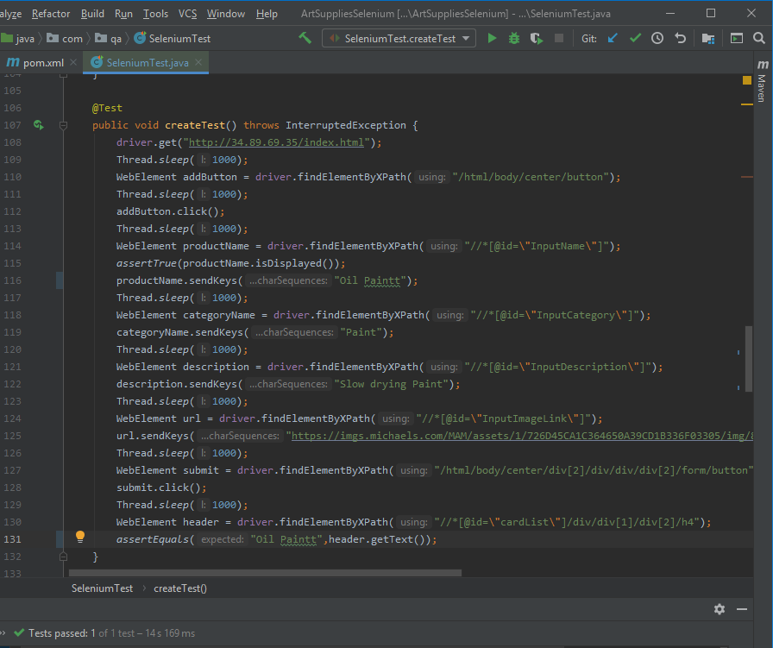
Selenium Test Example

Slide 11
What Went Well?
Front end design
Use of bootstrap e.g. cards
Create, Read and Delete functionalities
Clean delete process
Automatic refresh of products

Slide 12
What Do I Want To Improve?
Organisation via VCS and task management
Junit Testing and Test Driven Development
Continuous Integration

Slide 13
What Do I Want To Improve In My App?
Add another table
Create a list of products with a separate personal list
Improve the update function
Sort into categories
Prevent multiple entries
Notes:
http://34.89.69.35/

Slide 14
Thank you for listening
And thank you to everyone who has helped me with this project

